Slide 1


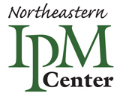
Susannah Reese, StopPests in Housing Project Manager sck27@cornell.edu
Cornell University’s NE IPM Center
June 27th 2019
HUD Region 3 Mid Atlantic Lead and Healthy Homes Summit
The Northeastern IPM Center receives support from the US Department of Housing and Urban Development’s Office of Lead Hazard Control and Healthy Homes through the US Department of Agriculture, NIFA agreement #2016-4866825905
Improving Housing Quality with Integrated Pest Management (IPM)

Slide 2
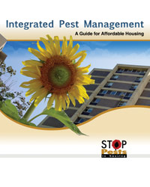
StopPests provides free training and technical assistance
Reduce pest infestations—Allocate pest control time & resources to solve pest problems with IPM
Prevent infestations—start pest-free and sealed up; educate staff, clients, and residents
Maintain— continuous monitoring and inspections
See: StopPests.org
IPM: A Guide for Affordable Housing
at www.stoppests.org/Guide

Slide 3
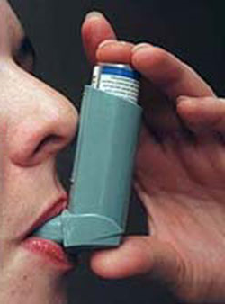
What do pests do to us?
Pests cause allergies & can trigger asthma
  Mice - 83% of all homes!
    95% low-income
    89% of schools!
  Cockroaches – up to 63%
Asthma: rate has doubled in 20 years
  Up to 30% or more of children under 18
  Main cause of lost school days… and work days!
  African American children are hospitalized and die 2x as white children; Latinos – 3x!
  American Indian/Alaska Native children are 60% more likely to have asthma as white children.
Bites can transmit Lyme, West Nile, Zika, rabies
  Thousands of rat bites each year in US!
Carry disease pathogens and contaminate food
  Rodents carry Hanta Virus, Leptospirosis, Plague, Rat-bite Fever, Salmonella, Typhus

Slide 4
What is IPM?
Integrated: Uses multiple approaches that work together
Pest: What the multiple approaches work to fight
Management: Use of the most economical means with the least possible risk to people, property, and the environment
Notes:
4
Integrated: sanitation, exclusion, and baits.
Pest: cockroaches
Management: no more cockroaches!
Suggestion: Ask trainees what they think of when they hear “management.”
Tell them that they will have to be pest managers, overseeing all of the time and watching for parts of the building system that need to be fixed.

Slide 5
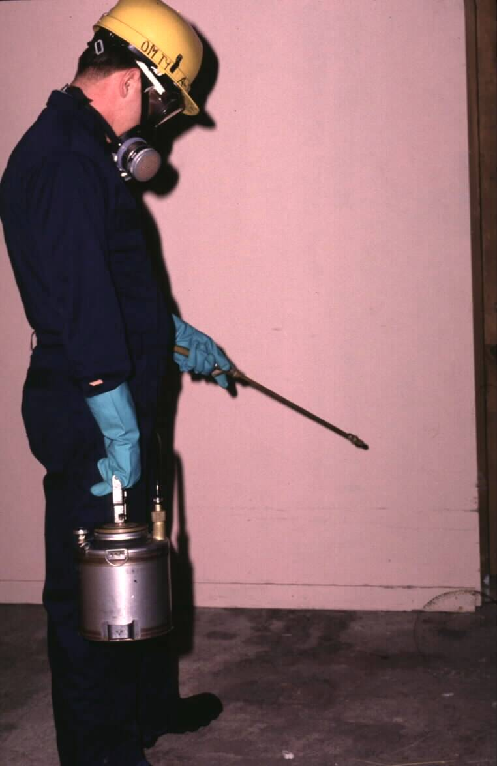

Routine spraying of pesticides is not an effective or safe option
"IPM effectively eliminates pests in safer and long term cost-effective ways than traditional pesticide treatments." HUD
Children and seniors are more susceptible to pesticides and deserve special protection.
Notes:
5
Refer back to the discussion at the beginning of the day about previous practices and their effectiveness.
Avoid disparaging pesticides. Put them in context. Pest management using only routine spraying of pesticides is akin to farming cockroaches. The building supplies food, water, and shelter for cockroaches to thrive in, and once a month some are harvested (killed by pesticides). As long as food, water, and shelter are present, the cockroaches will be there too. Pesticides work to kill most of the time, but they do not solve the ongoing problem and may pose unnecessary risk.

Slide 6
Pesticide risk by application method
Less risk of exposure
More risk of exposure
Tamper- resistant station
Gel bait
in a crevice
Total release fogger
Notes:
Risk of exposure is the risk of coming in contact with a pesticide. Note that touching a pesticide that can be seen is not the only way to be exposed to pesticides. Get trainees to think about pesticides getting into the air and remaining on surfaces even when they can’t be seen or smelled.
Another risk to consider is that someone could misuse a pesticide by applying it incorrectly.
Suggestion: Have trainees think of and place on the gradient one or two other application methods they have seen.

Slide 7
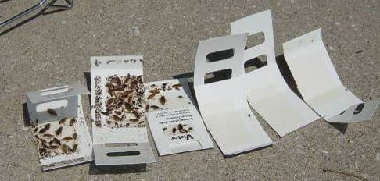
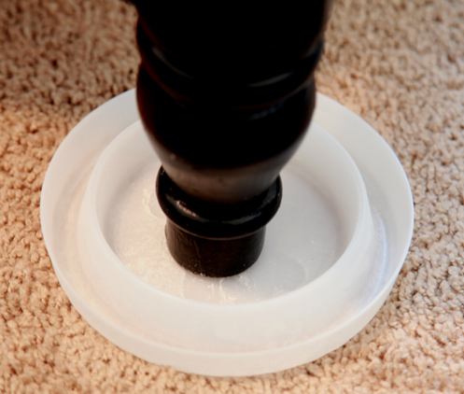
Pest Problem Solving
Inspect and monitor
Identify
Take control measures
Evaluate effectiveness
Sticky traps used to monitor for cockroaches and interceptors used to monitor for bed bugs are an essential part of an IPM program and make inspection easier

Slide 8
Challenges to Implementing IPM in Affordable Housing

Slide 9

The blame game
Management did nothing!
The exterminator did nothing!
I used 6 bug bombs and I’m still getting bites!
I called our guy and he sprayed.
I can’t treat this apartment, the resident is unprepared.
The tenant keeps bringing them back in the building!
Notes:
I go around making the case for pest management professionals being more like doctors than plumbers. Work together and be part of the conversation. We need to step up to the plate and be interested in all of the solutions to our pest management problems.

Slide 10
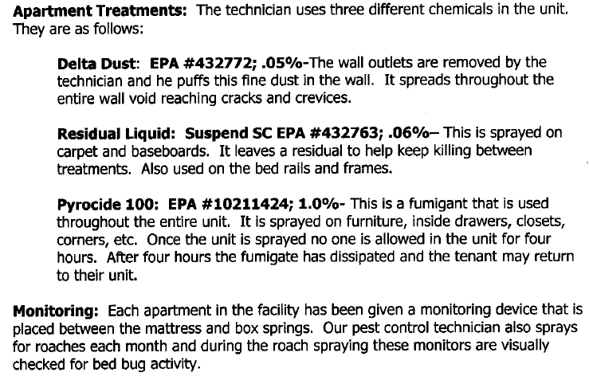
Poorly written contracts
Notes:
These are all pyrethroids. Should include a combination product (neonicitinoid + Pyrethroid) or desiccant dust. (And pyrocide is not a fumigant)
Bed bugs have developed resistance to pyrethroids

Slide 11
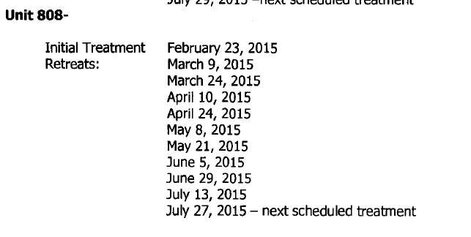
No contract oversight
$500 +
$500 +
$500 +
$500 =
$2000
11 treatments?!
Who is paying attention?

Slide 12
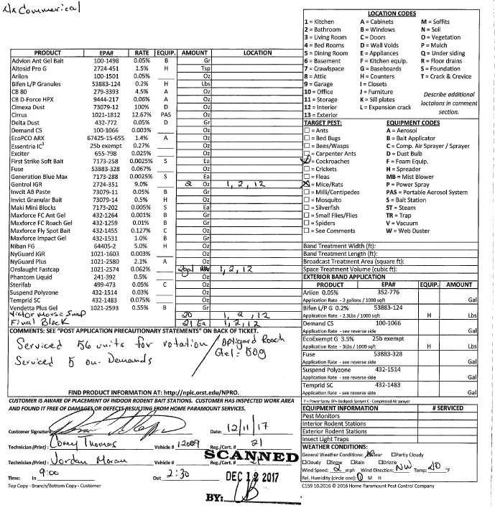
Low-bid/one-size fits all contracts
These technicians visited 61 units from 9am to 2:30pm. 330 minutes ➗ 61 = 5.4 minutes
(3 minutes per unit?)

Slide 13
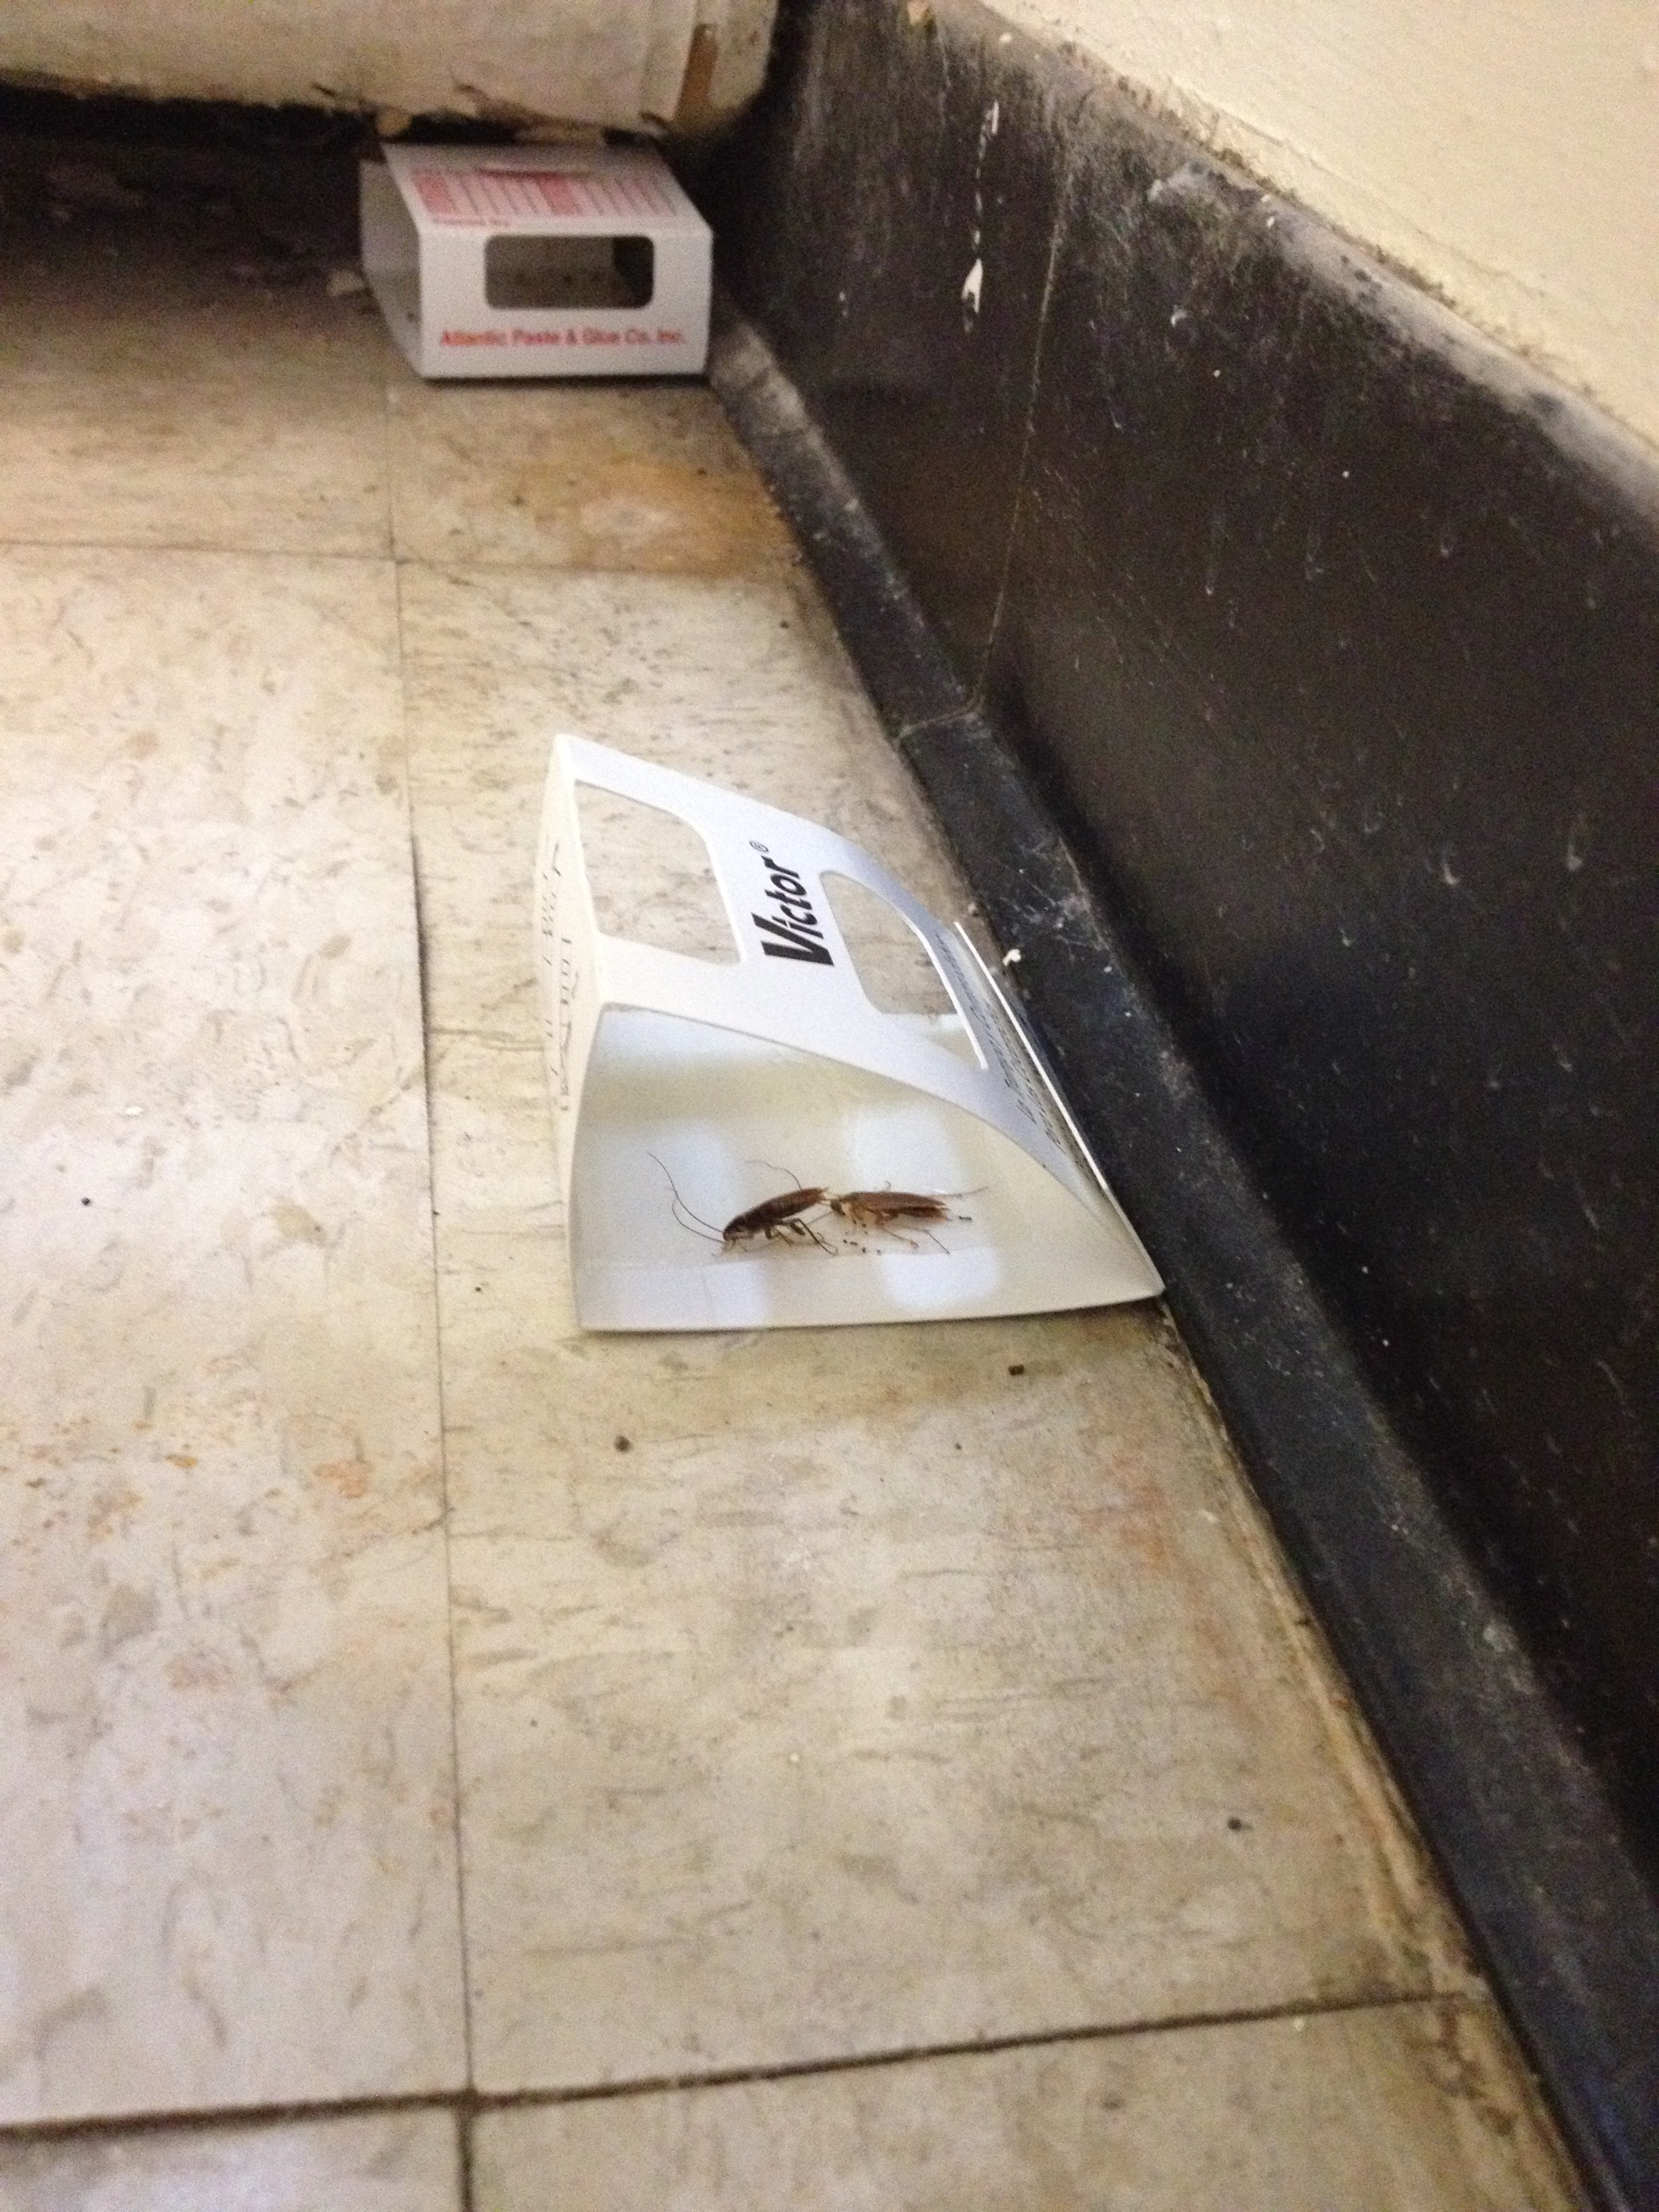
Monitoring is lacking & REAC discourages use

Slide 14
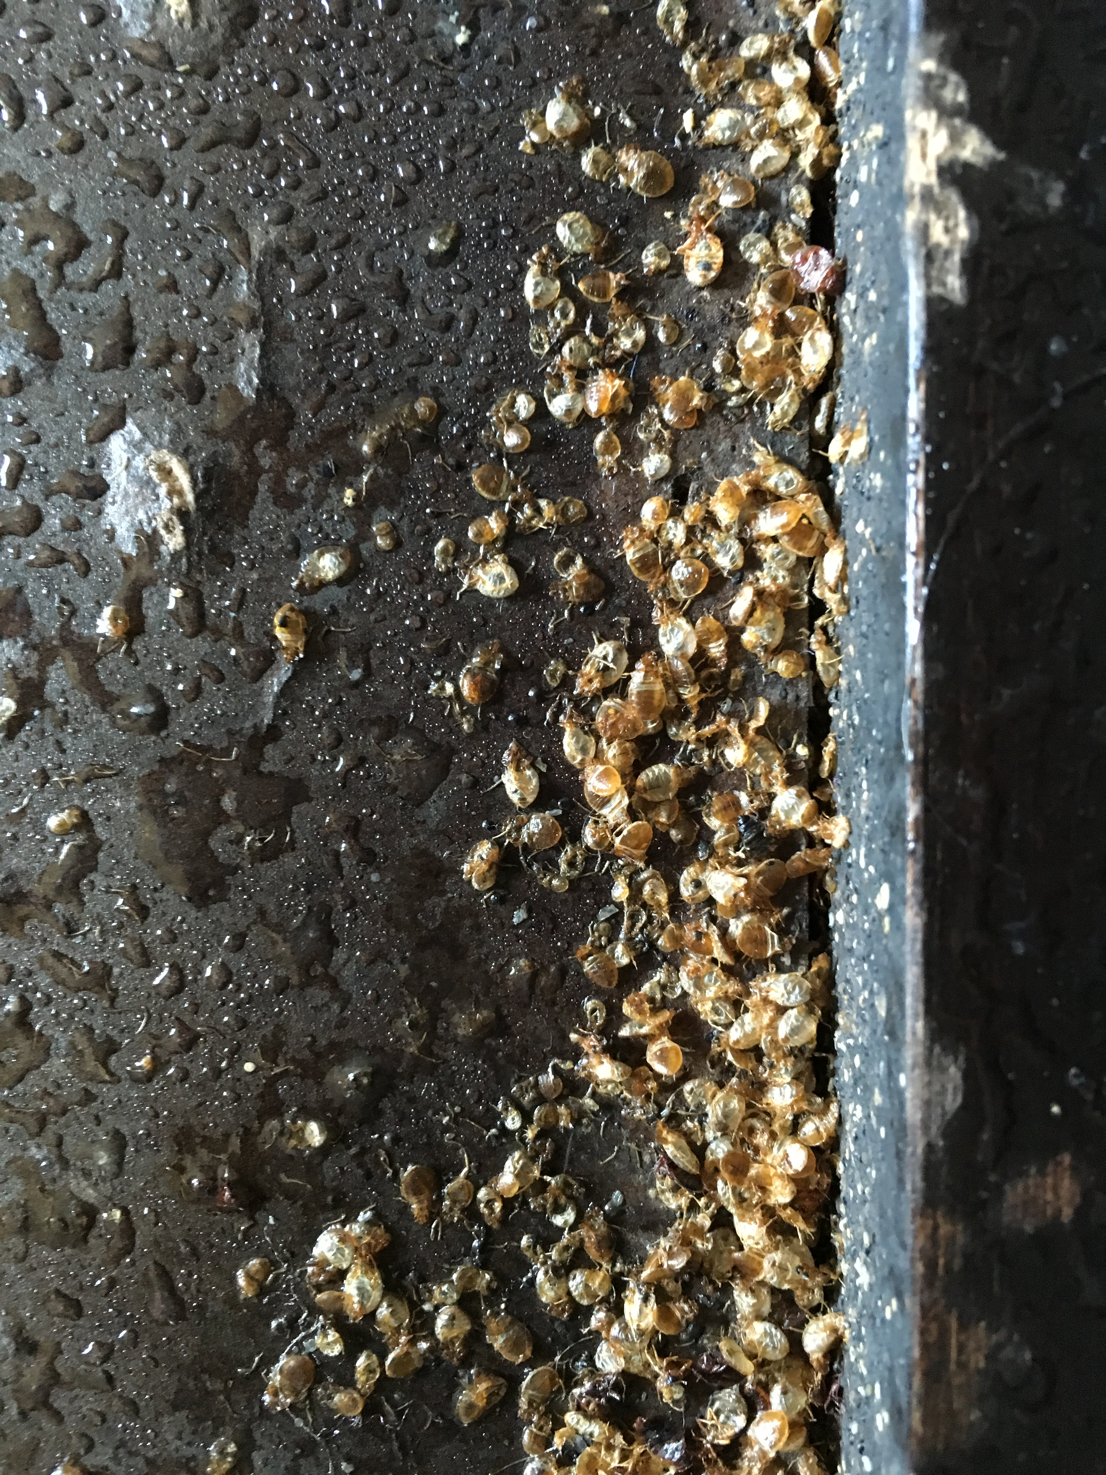
Over-reliance on sprays

Slide 15
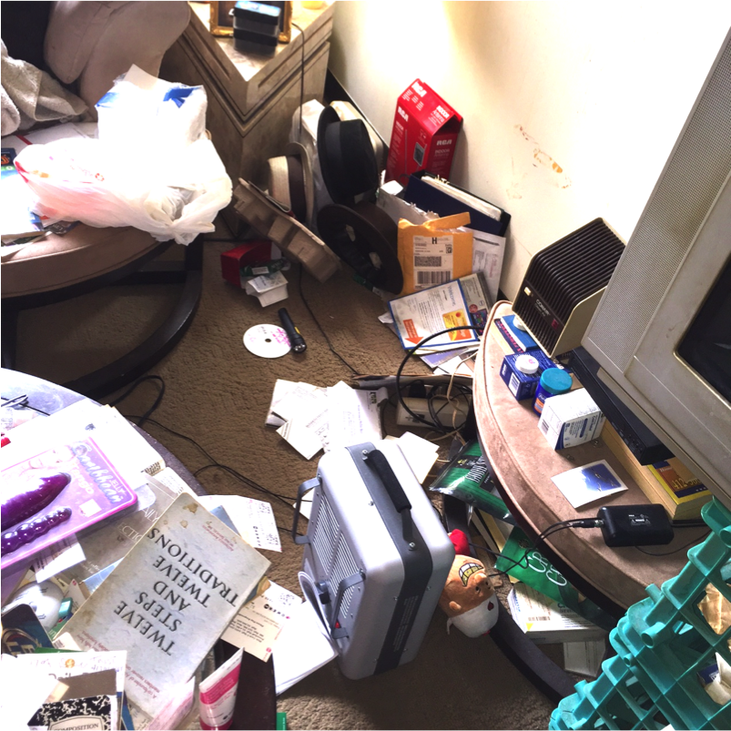
Clutter and sanitation

Slide 16
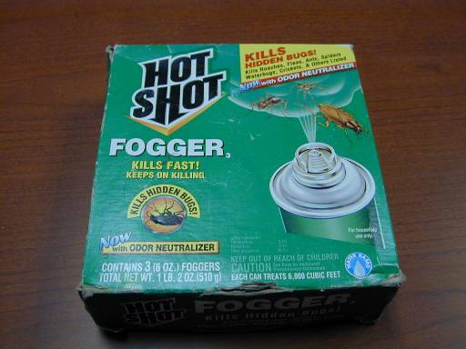
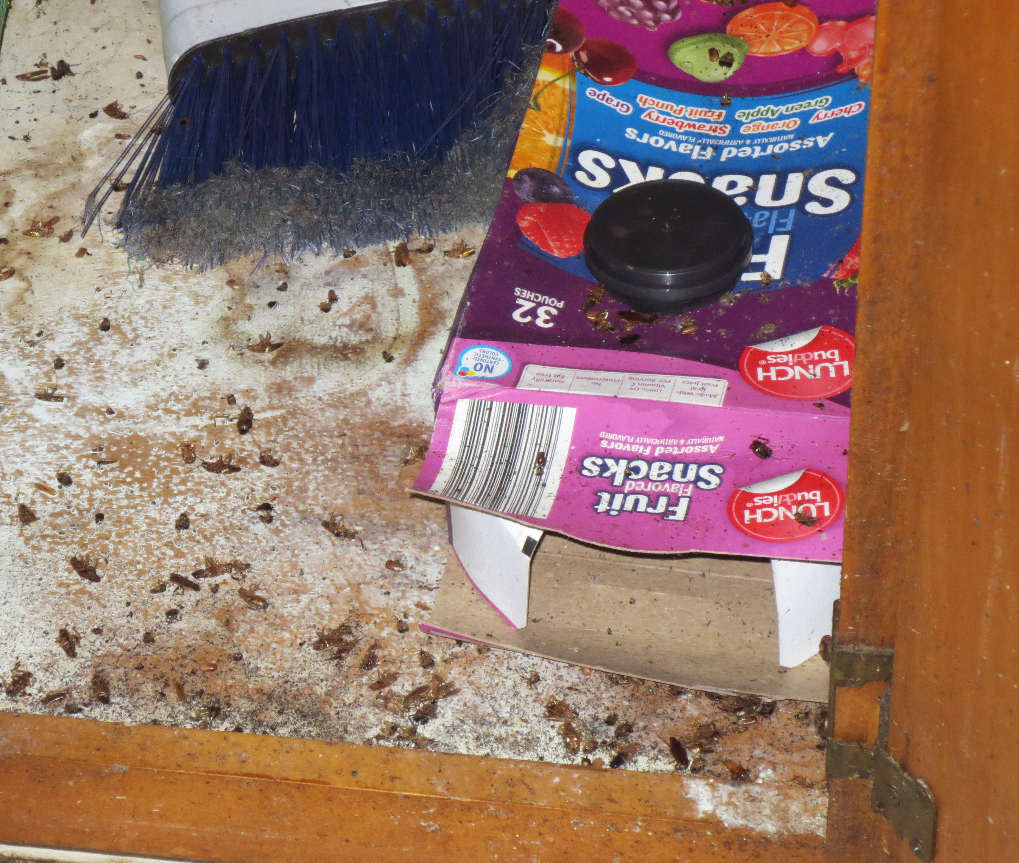
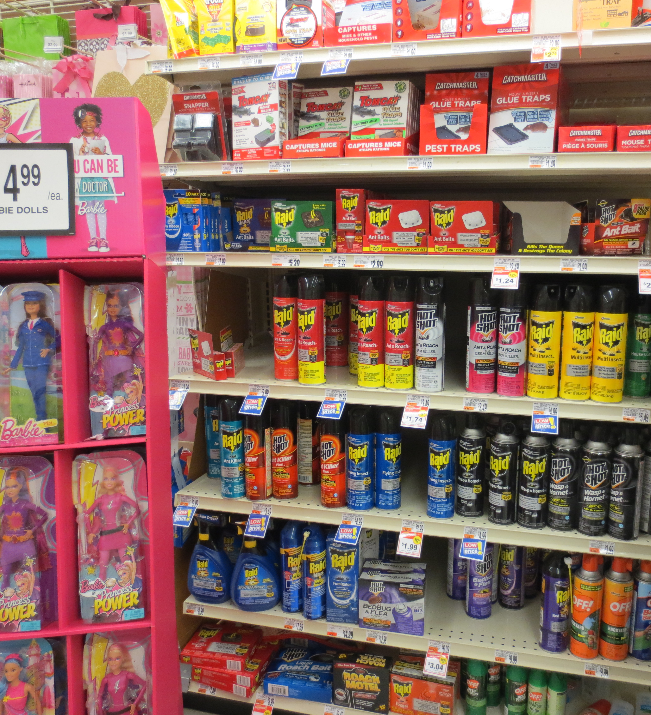
Self-treatments

Slide 17
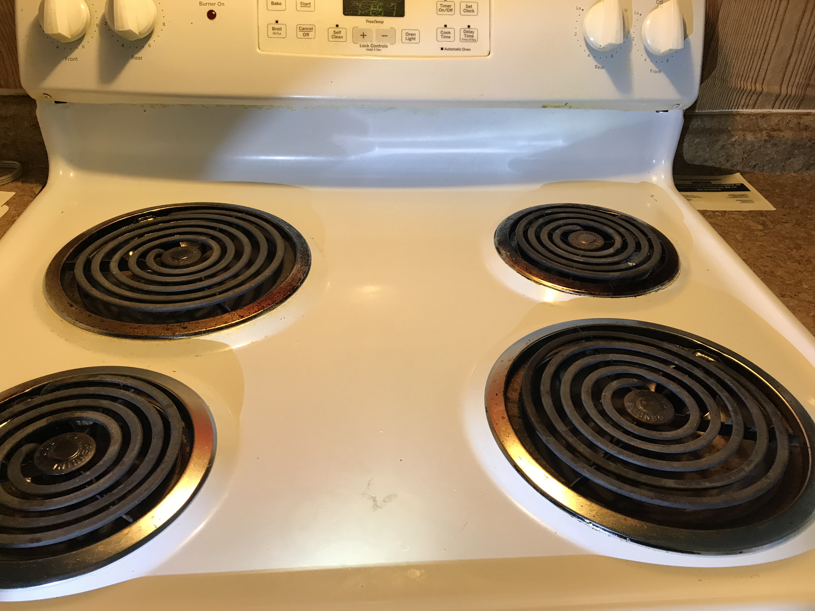
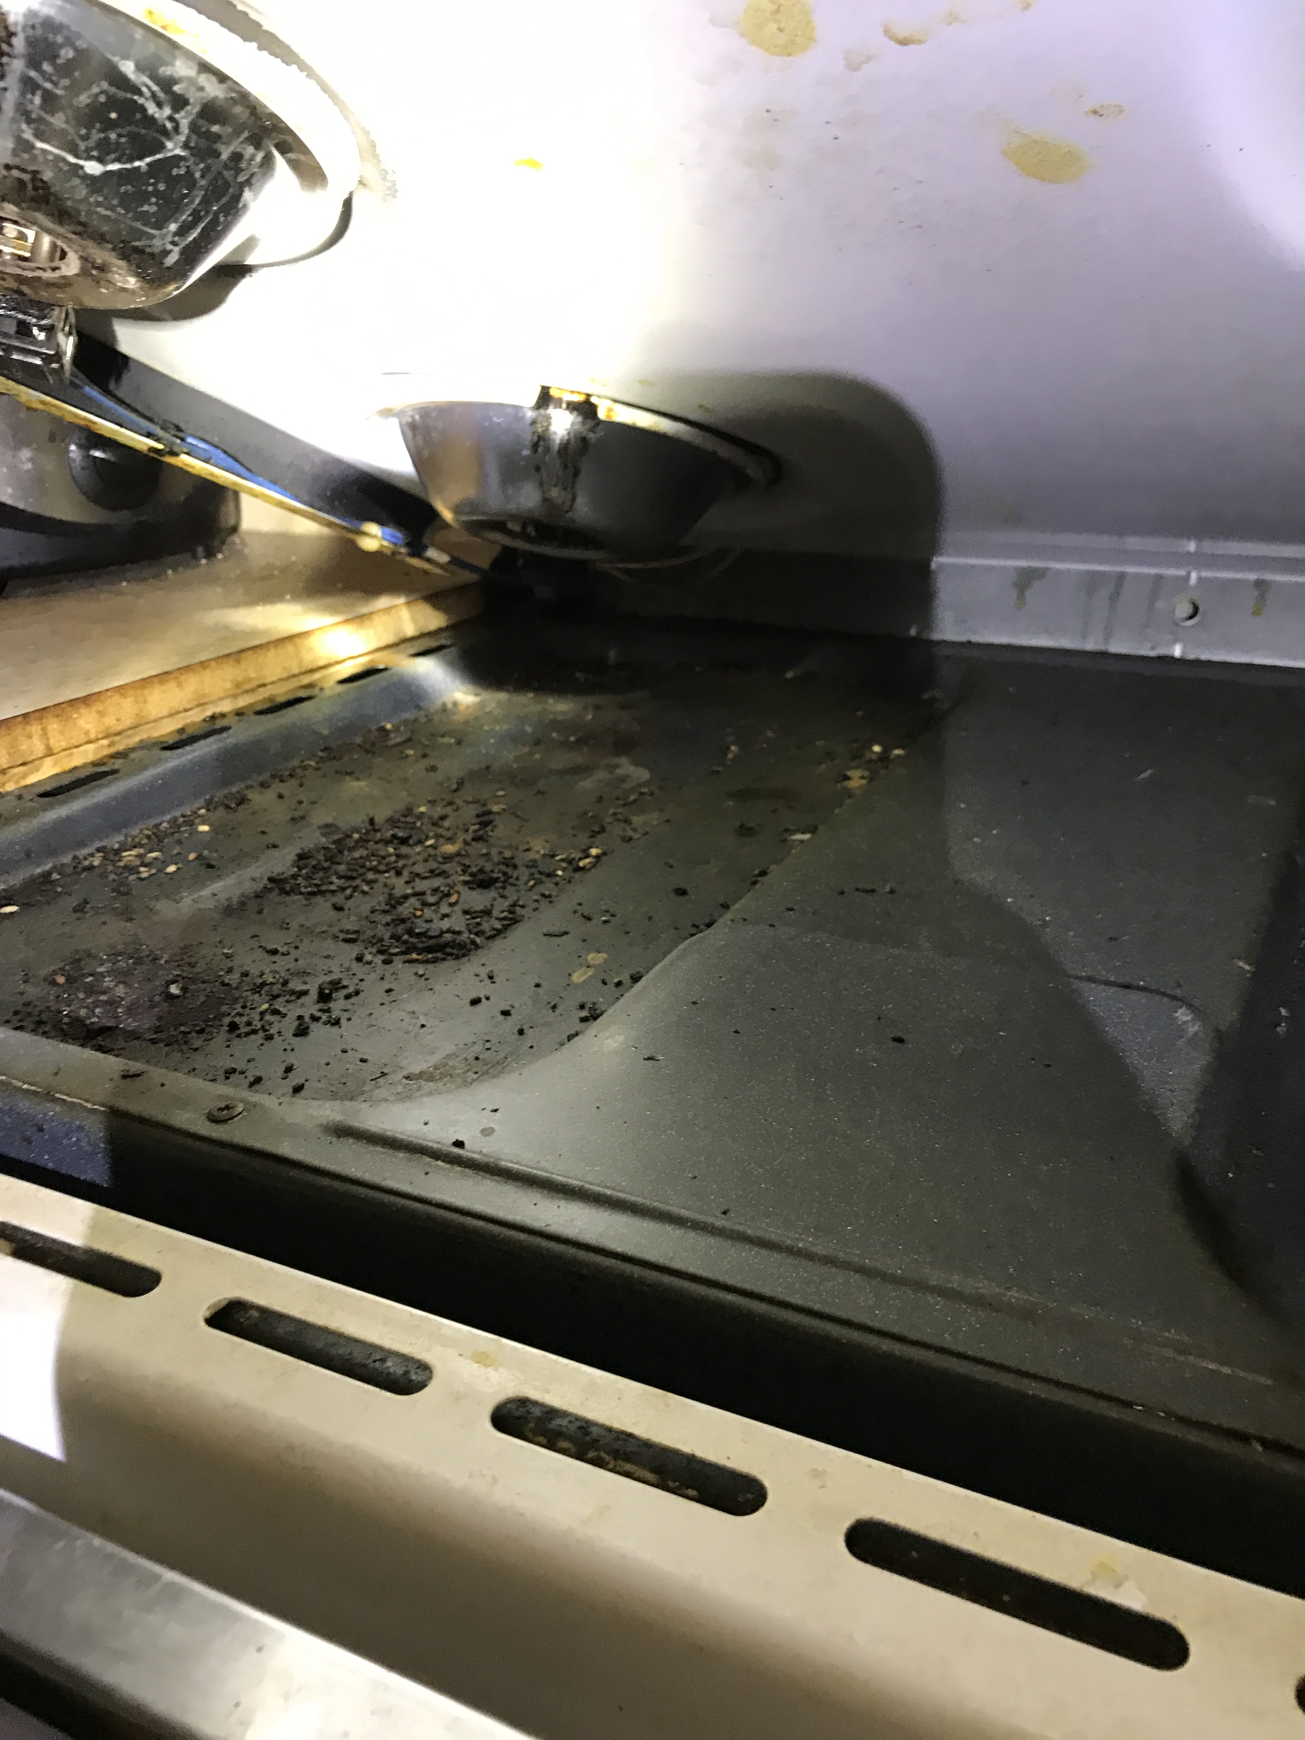
Mice…..

Slide 18
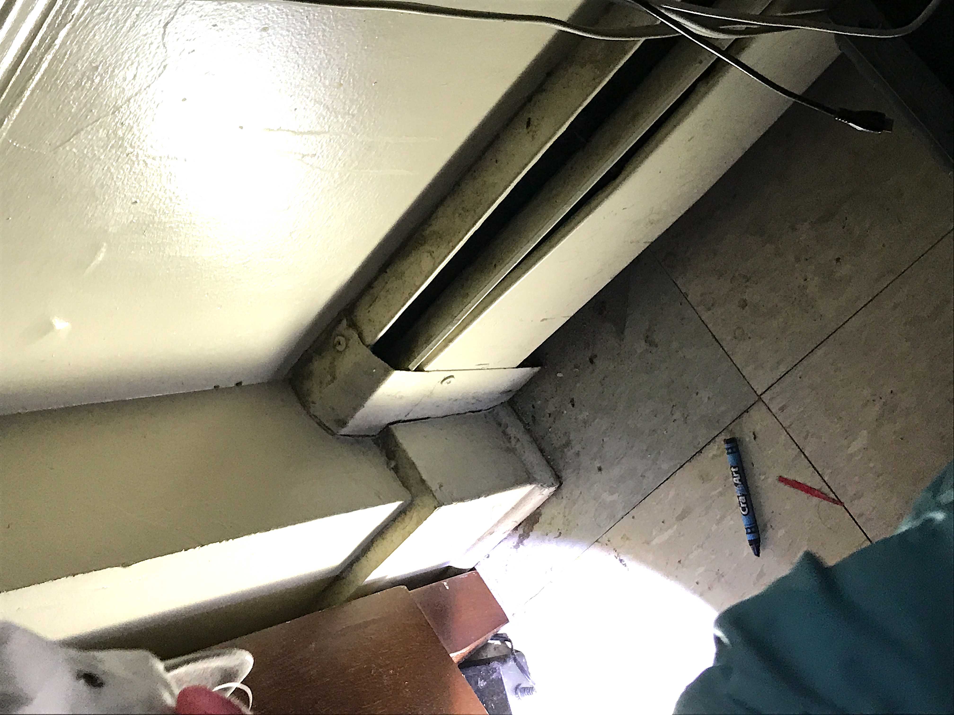
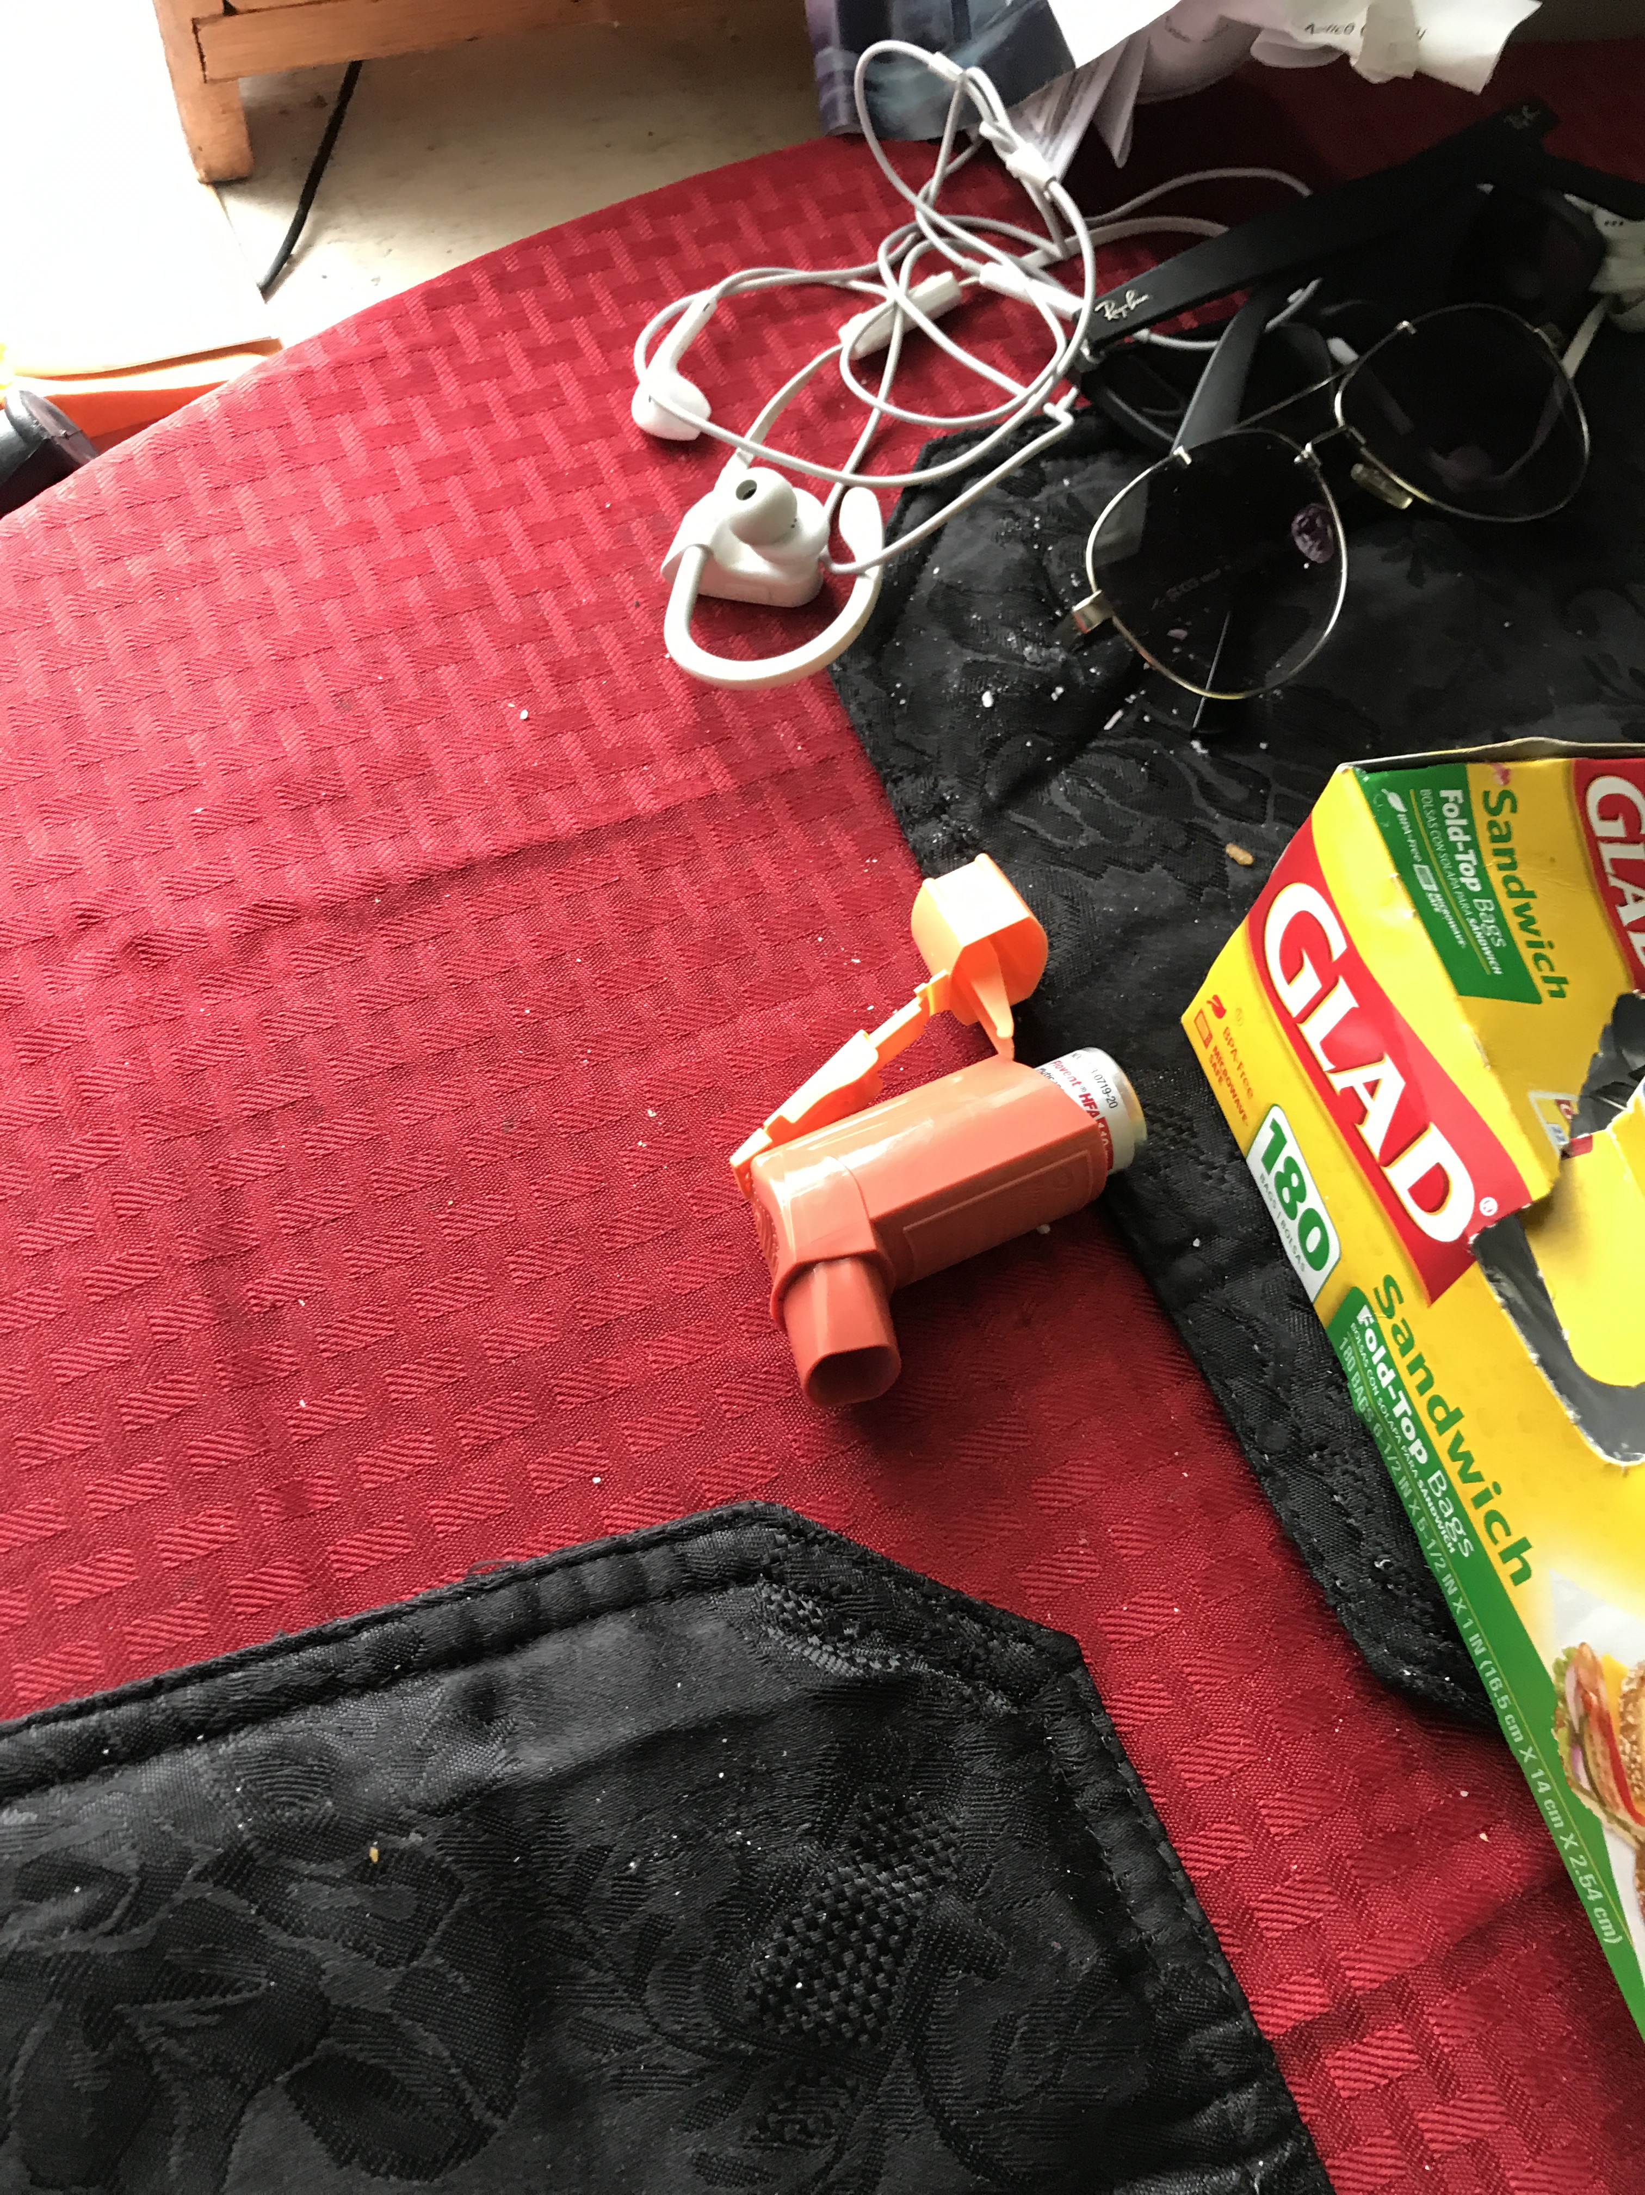
Mice and asthma

Slide 19


IPM for bed bugs is tricky…
Food
Water
Shelter
Can we eliminate
these for bed bugs?
Food
Water
Shelter
Notes:
19
Pests require three things to survive: food, water and shelter. Without any of the three, they won’t “stand up.” The three legged stool illustrates this point.

Slide 20
Solutions

Slide 21
Designated IPM Coordinator
Works with Staff:
Meet meet meet –with staff, residents and pest control company/technicians
Reviews work order system and flags focus units for follow-up
Works with Contractor:
Reviews contract – knows what’s in it
Outlines best practices for pest control in next RFP
Keeps records and periodically reviews service tickets and records
  Directs pest control time and resources to heaviest infestations first
  Evaluates success or failure to eliminate pests. Holds contractor accountable.

Slide 22
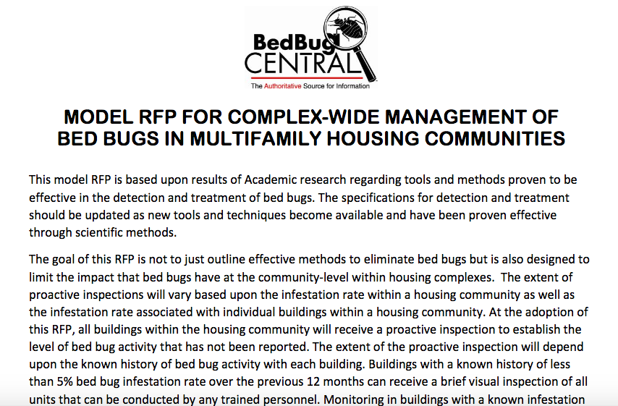
Detailed scope of service

Slide 23
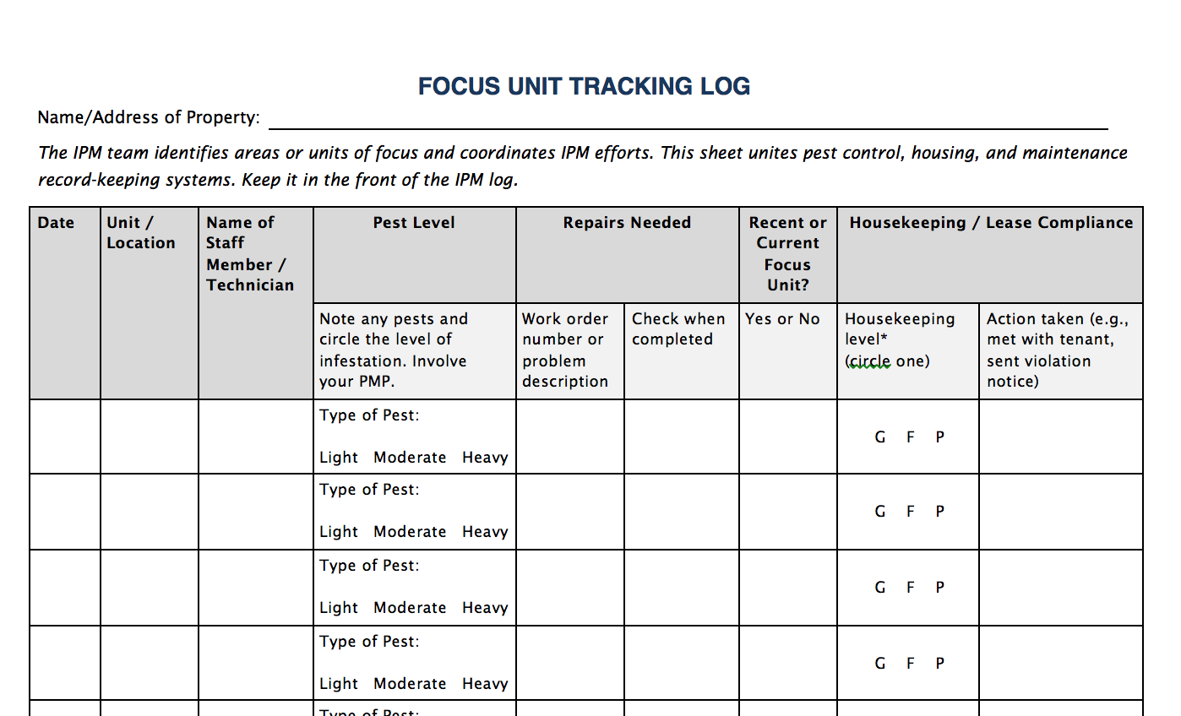
Recordkeeping
Find this log at StopPests.org

Slide 24
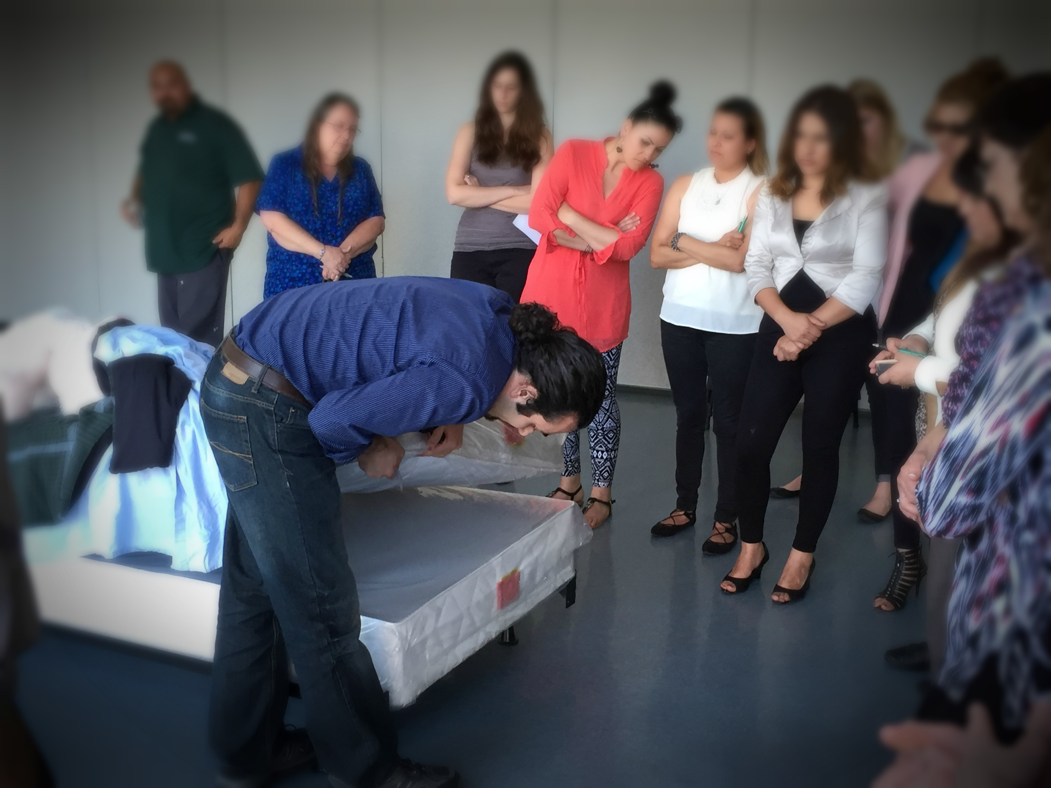
Education and training

Slide 25
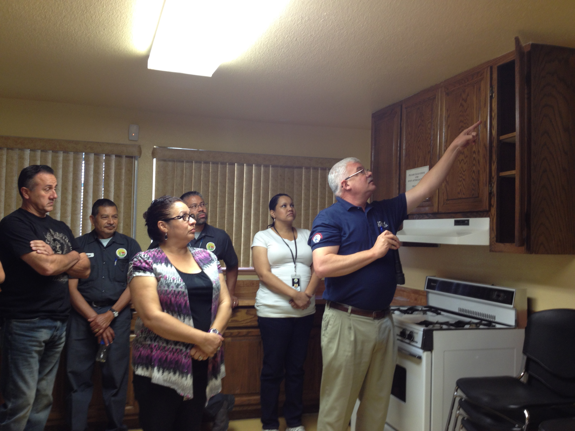
TEAMWORK approach

Slide 26
The IPM team
Property
Manager
Pest
Management
Professional
Resident
IPM
Coordinator
Landscaping
Services
Resident
Support
Services
Maintenance
crew
Procurement
Specialist
Janitorial/
Custodial
Notes:
Give a brief introduction to the IPM team approach. Note that housing management and HUD have agreed to support the use of IPM. IPM and roles and responsibilities will be further discussed throughout the day.
Explain how education and record keeping can be used to control pests. Education results in people in the housing community changing behaviors so that the property is inhospitable to pests. Record keeping brings accountability to pest management and ensures that problems are fixed before the infestation grows. Documentation and education will be in every aspect of pest management.
IPM Coordinator Makes sure all jobs are funded and completed. The property can’t outsource the responsibility for quality assurance of an IPM program.
Property Manager Responsible for the time and resource allocation at the property and often sets the tone for resident involvement.
Resident Support Services Gets assistance for residents.
Janitorial/Custodial Services Cleans common areas.
Building Superintendent Maintenance Crew Fixes moisture issues and makes repairs that block pests.
Resident Cleans regularly and prepares unit for inspection and necessary treatments.
Pest Management Professional (PMP) Conducts inspections and applies pesticides that pose the least risk to human health and the environment.
Landscape Services Chooses plants that are pest-resistant and grow with minimal chemical assistance. Minimizing rat habitat should be considered when planting.

Slide 27
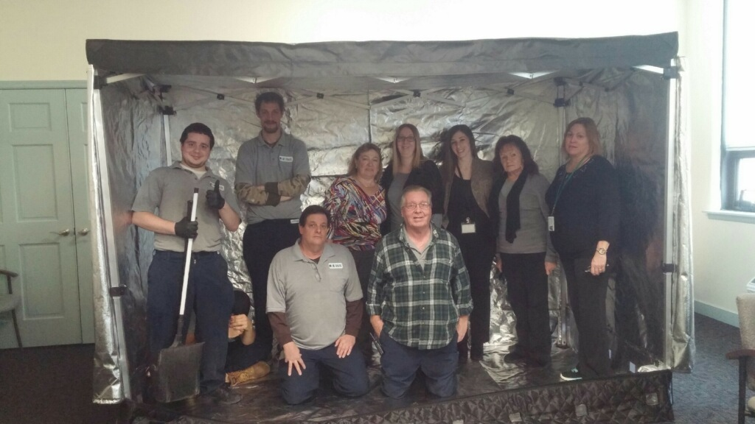
Staff have defined roles

Slide 28

Leverage connections
Mental health
Housing services
Protective services (older adult, child, animal)
Public health (nurse)/Board of health
The local health department (inspectors, sanitarians, community health workers)
Zoning/Inspectional services
First responders (fire, police, EMT)
Social worker
Home-based care
Heavy chore service
Legal services
Weatherization
Literacy
Smoking cessation
Asthma initiative (health dept, children’s hospitals, American Lung Association, EPA asthma Partnership)

Slide 29
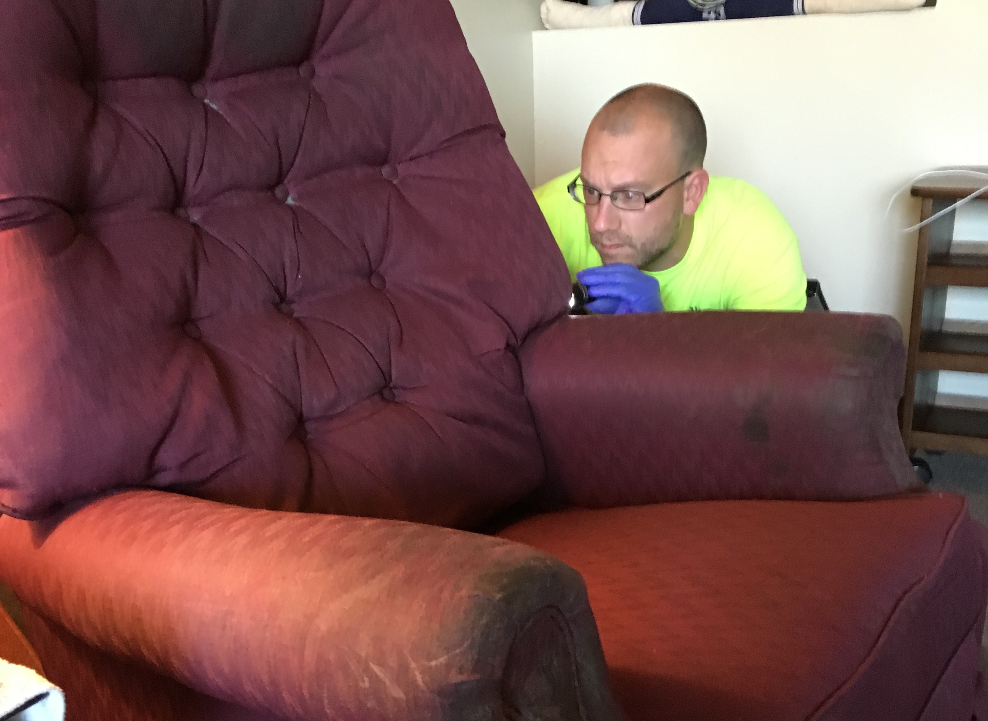
Proactive Inspection Schedule
(don’t rely on reports of pests)

Slide 30
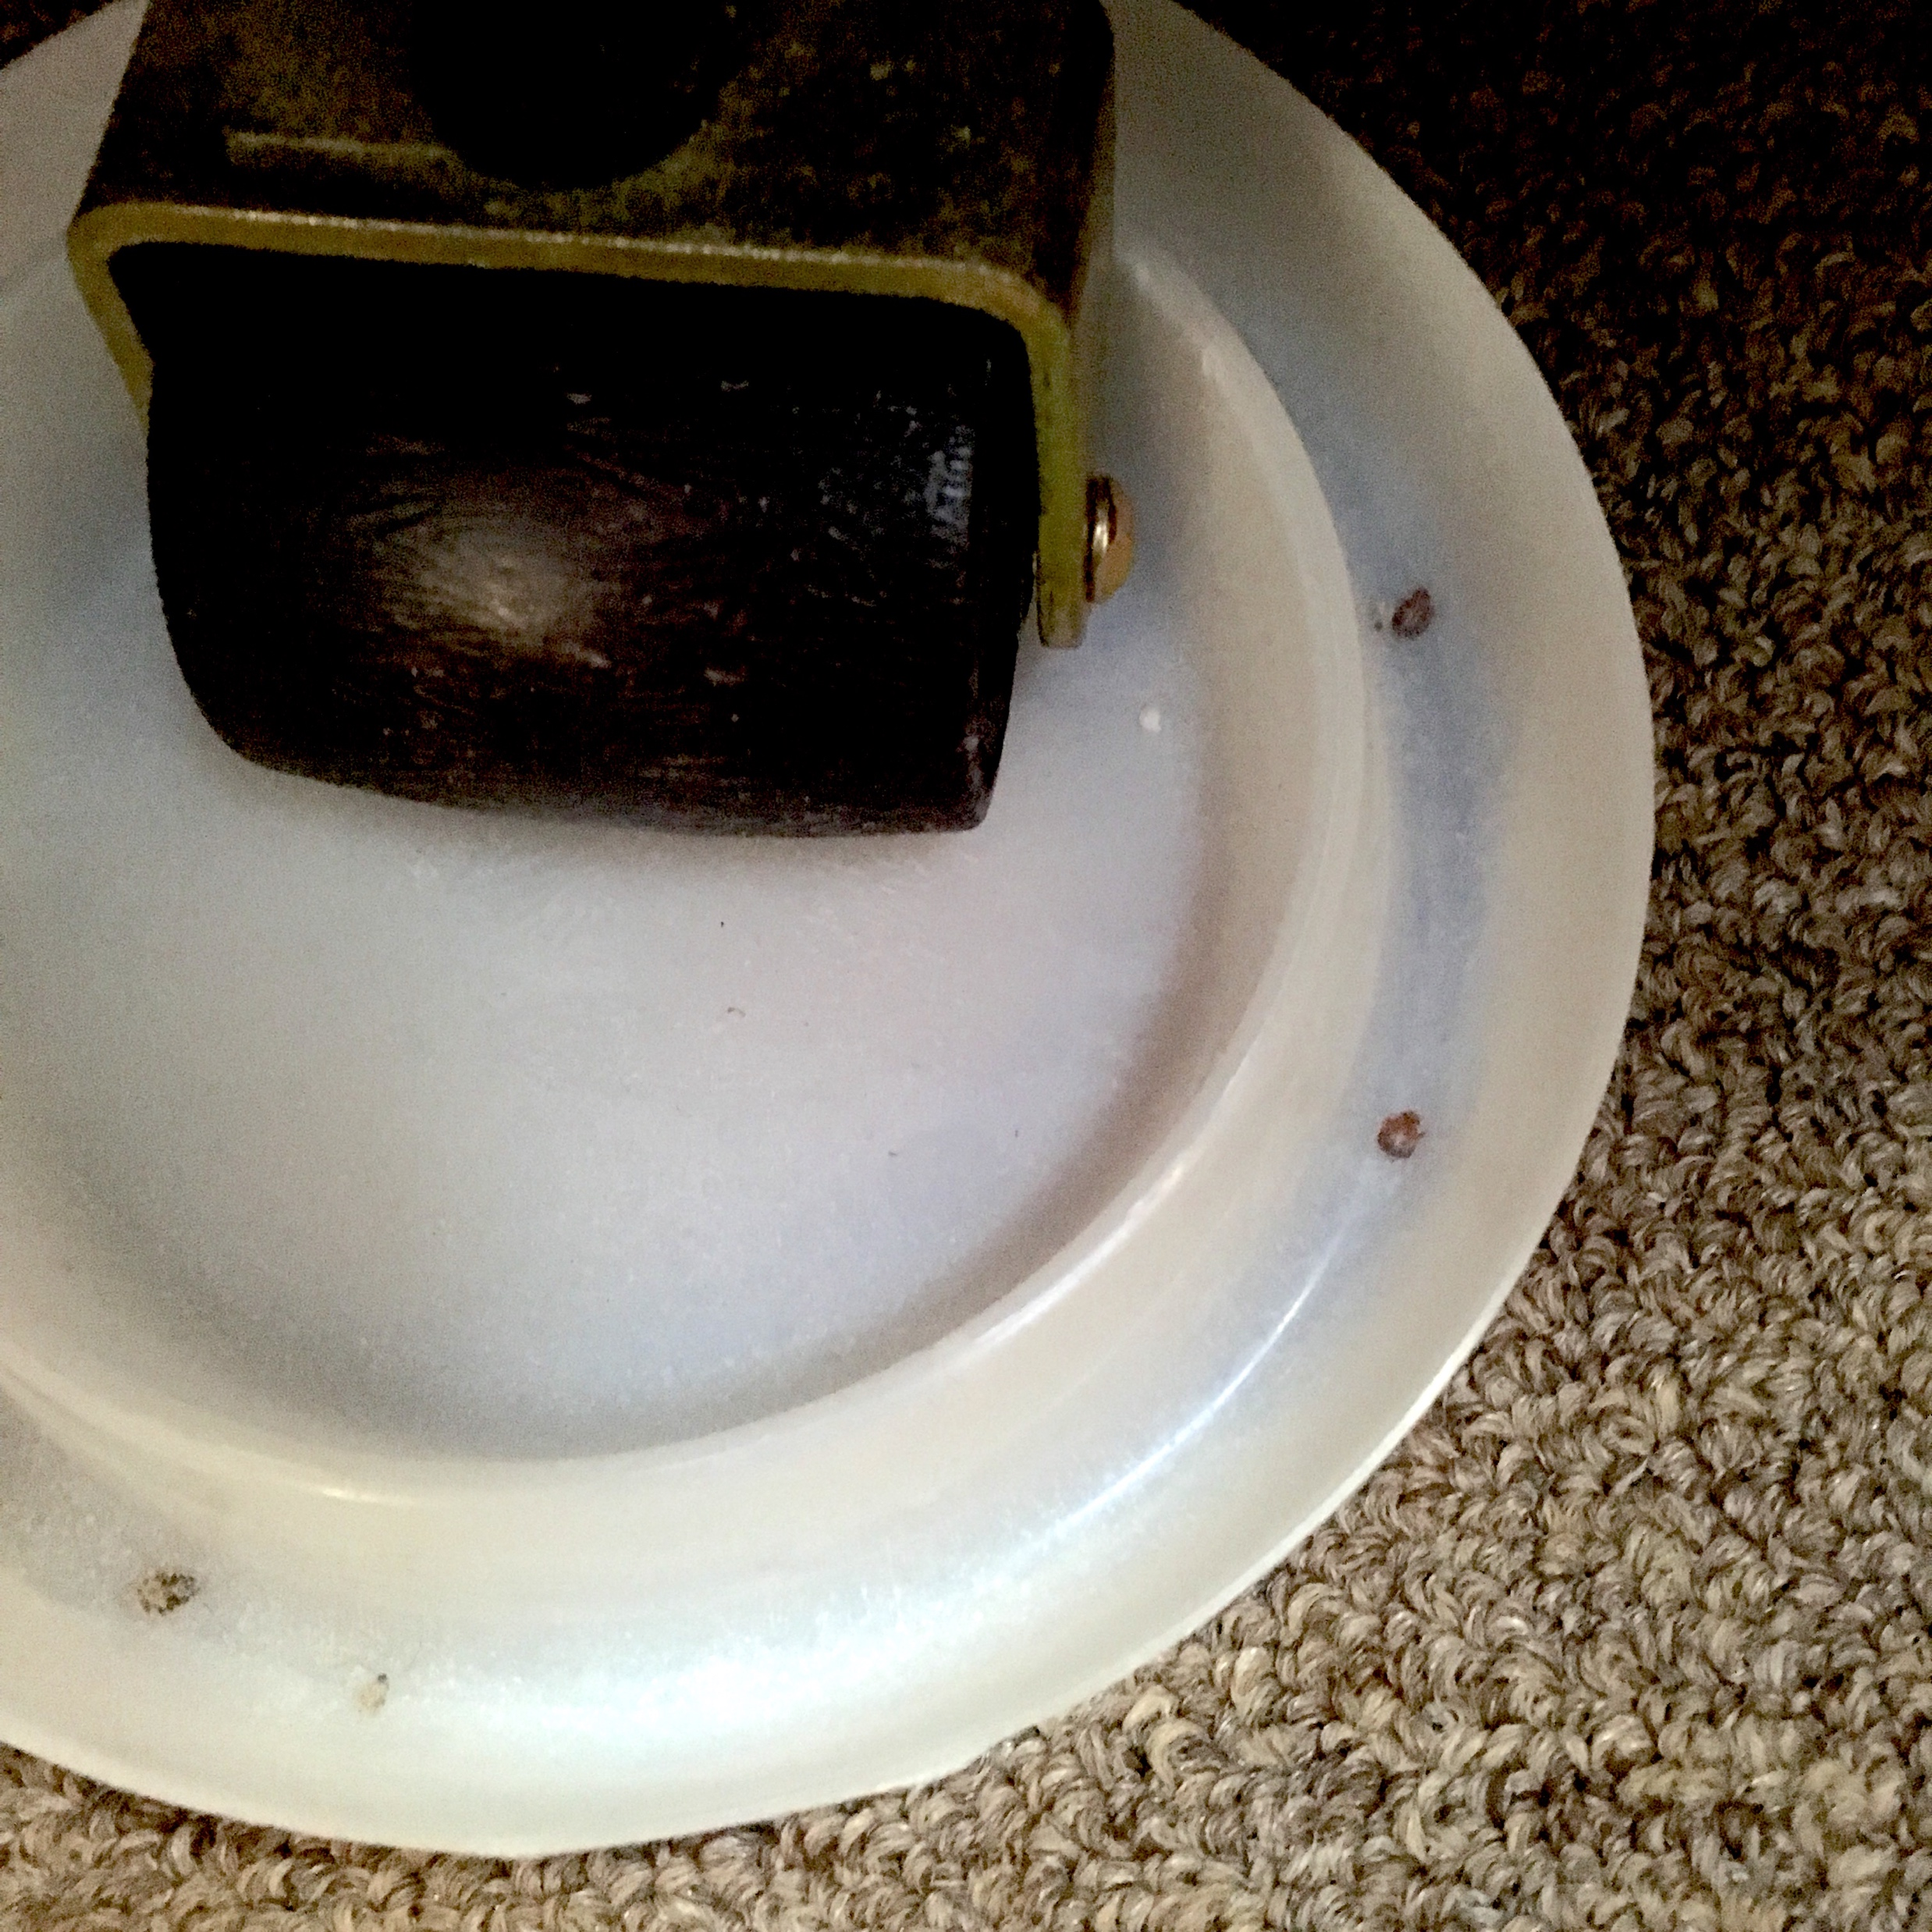
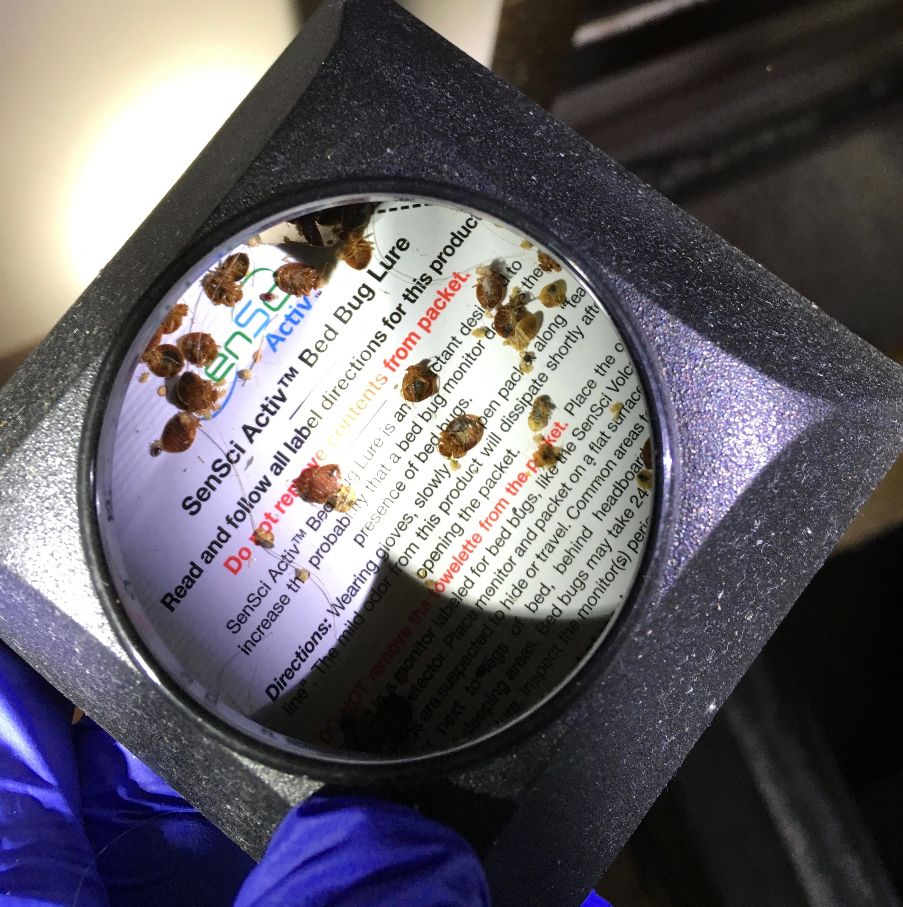
Monitors!

Slide 31
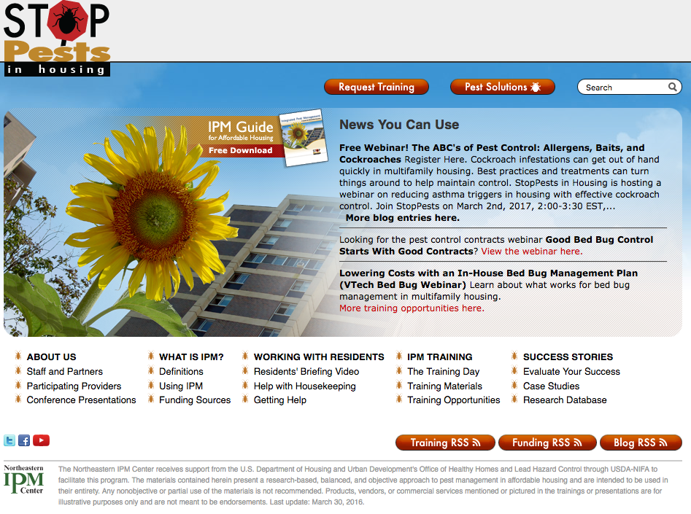
Visit StopPests.org for more information and resources

